Slide 1
Capstone project -bdm
By: 21f1005532@student.onlinedegree.iitm.ac.in
The data in this project is collected from the retail cloth store named: Sanjay vastra bhandar which is located at Bharweli ,Balaghat.
The store is owned by Mr. Ravindra.
The data is collected by going to the shop on Sundays and Wednesdays.
The data is for the complete month of February.
The project includes analysis based on daily sales , daily revenue ,weekly incoming stock of 10 major products of the store.

Slide 2
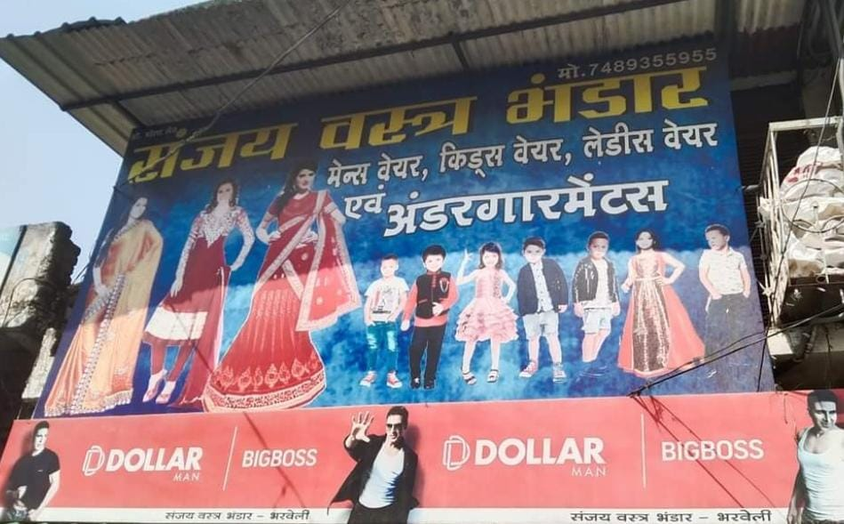

Slide 3
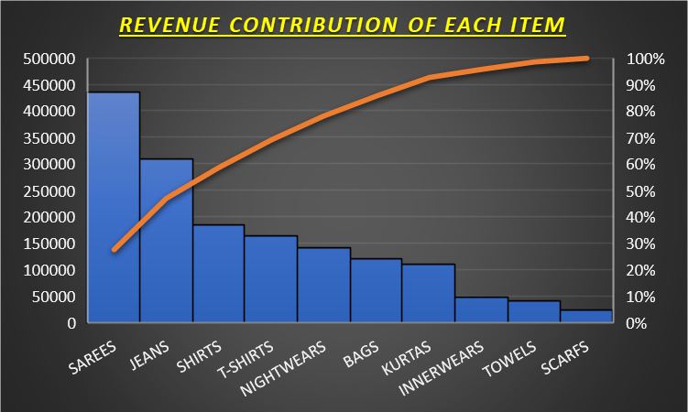
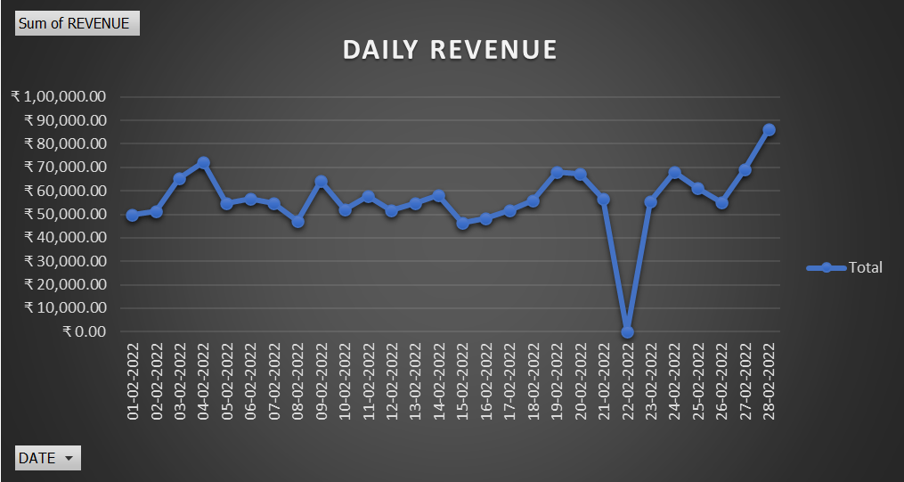
Revenue Analysis/observations:
The major share of revenue is generated by sarees followed jeans.
The traditional wears such as Kurtas and Sarees sales were comparatively higher on the day before Basant Panchami (4-2-2022) and on Mahashivratri (28-02-22).
The revenue on 22-02-22 is zero because the store remains closed on 4th Tuesday of every month.
The salary of the staffs is Rs.5000 for each month (there are 4 staffs) and all the other expenses such as transportation of incoming stock from wholesale traders is approx. Rs.15000 which gets excluded from the Revenue.

Slide 4
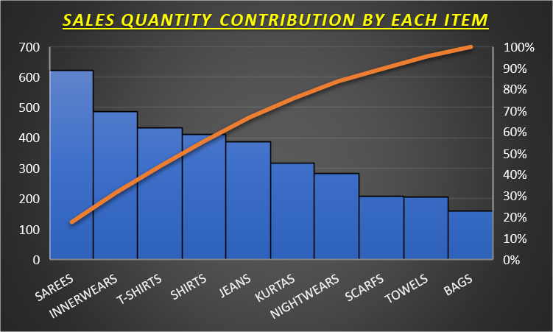
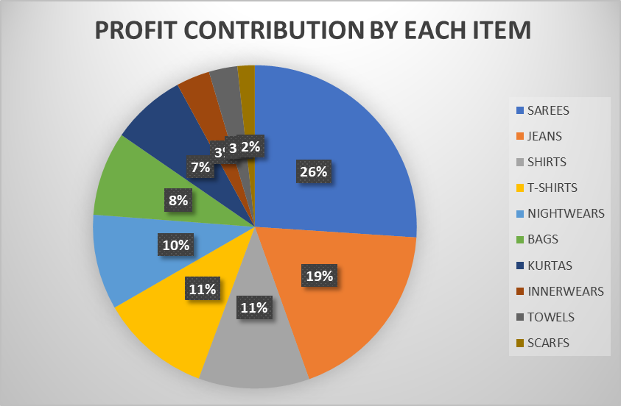
Sales/quantity analysis:
The quantity of sarees and inner wears ,T-shirts , Shirts, Jeans is quite higher than the others.
The increase in sales of T-shirts is observed in ending 10 days of February as days are getting hotter.
Profit observations/analysis:
The major share of profit is generated by sarees , jeans.

Slide 5
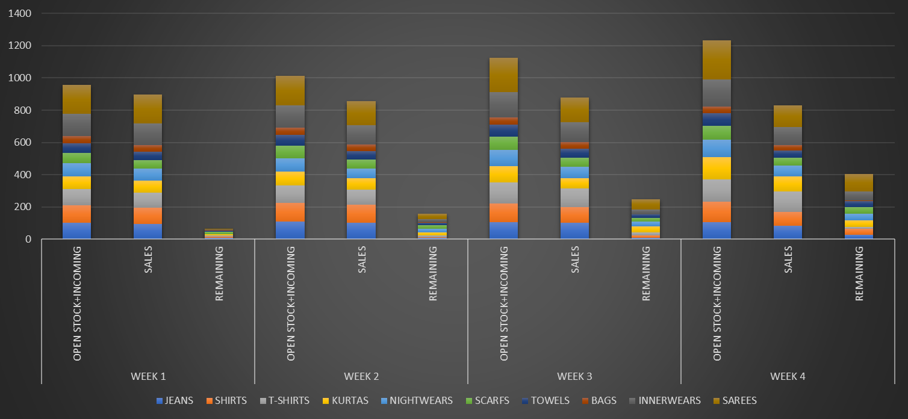
Weekly Stock analysis:
We can observe from the graph that remaining stock is increasing week by week which is at times bad for the store as it will increase the dead stock.
Because of the festival it can observed that incoming stock is more comparatively than the other weeks.
Recommendations: > variety in high selling items can be increased.
> festive times can have sale to attract more customers.
> according to my observation ,the quantity of bags incoming stock can be increased as the variety was low.
> a website can be developed to attract more customers and can make pages on social media to advertise the store .

